Slide 1
Classroom Group Functionality
Group Members:
Ritik Tiwari (B21CS098)
Priyanshu Kumar (B21CS061)

Slide 2
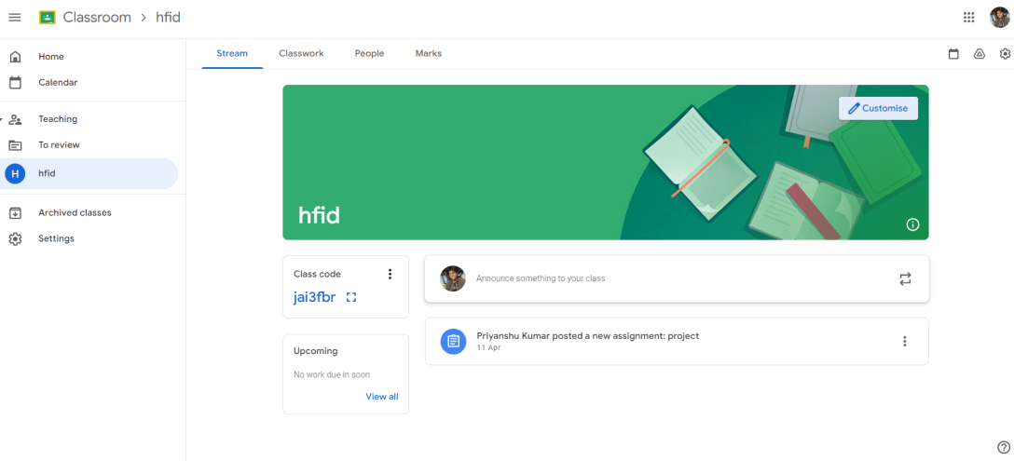
Here when there are two options enable for the professor, Classwork and Marks when professor created Classwork then it may return the marks to the groups. Lets say professor first assign the works to the groups.

Slide 3
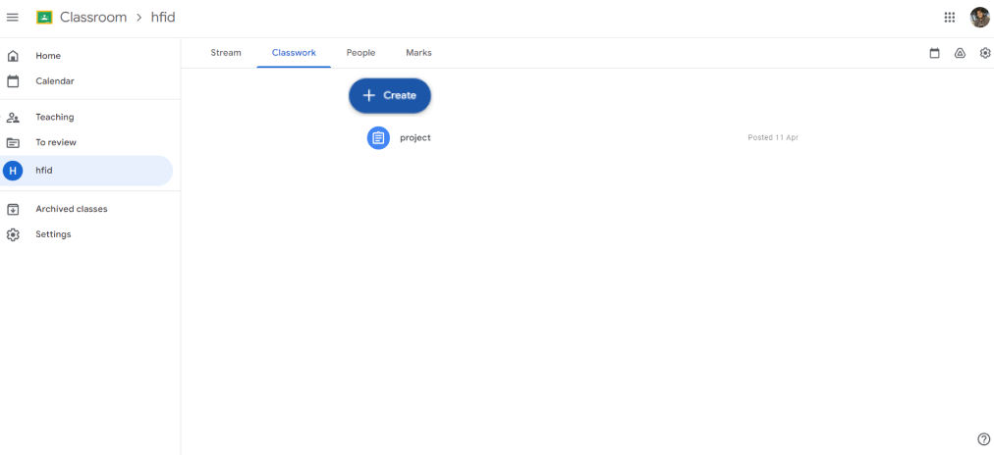
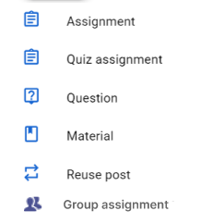
Introduction
Here when professor taps on the create button then he will get multiple option but for now we are enabled the group assignment option and on tap there will task assign screen opens like the google classroom.
At Contoso, we empower organizations to foster collaborative thinking to further drive workplace innovation. By closing the loop and leveraging agile frameworks, we help business grow organically and foster a consumer first mindset.

Slide 4
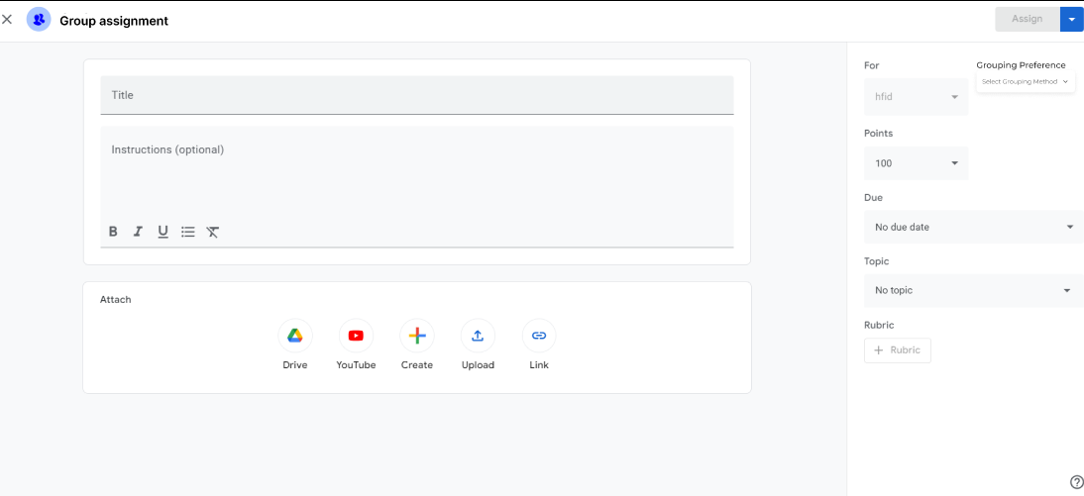
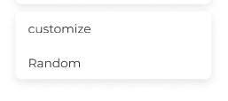
Primary goals
Annual revenue growth
Here there are the general options for the professor and also the option which we have given like for the grouping preference whether it’s customized or random and there is one more option assign which will assign the task to the groups but first professor have to choose the student groups lets say professor tap on the random group preference.

Slide 5
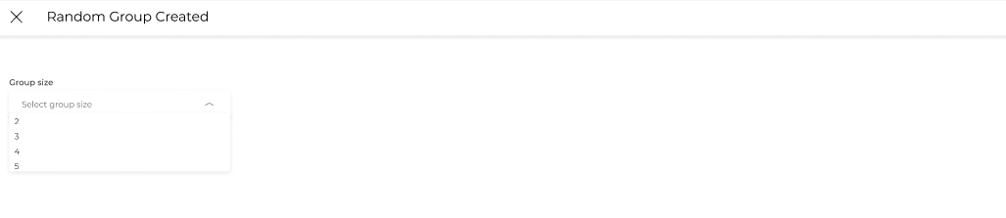
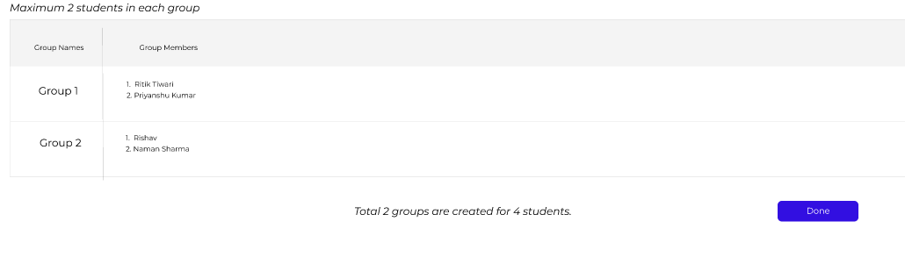
Areas of growth
Here we have given the option for the professor to choose what group size he wants to create. For this example we have taken the group size as 2.
 | B2B | Supply chain | ROI | E-commerce
Q1 | 4.5 | 2.3 | 1.7 | 5.0
Q2 | 3.2 | 5.1 | 4.4 | 3.0
Q3 | 2.1 | 1.7 | 2.5 | 2.8
Q4 | 4.5 | 2.2 | 1.7 | 7.0
With the 4 students of group size 2 we got 2 groups and as it’s random group creation the students are assigned randomly according to roll numbers. Now on tap of done we will again redirected to group assign screen where on the tap of the assign button the task assigned successfully to the groups.

Slide 6
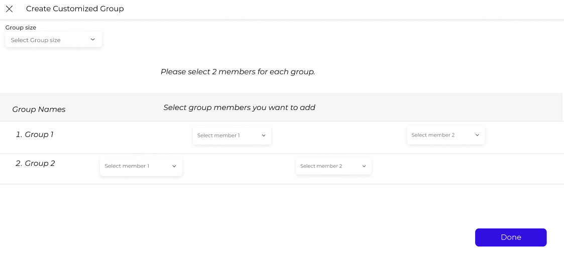
Business opportunities are like buses. There's always another one coming.
“
”
Richard Branson
When professor taps on the option group created using the customized way then this screen will appear and here also first we have to choose the group size of what professor want’s to create and then according to this example let’s say 2 groups he wants to made and here in each drop box there are student options who are in the classroom and professor can select students for each group.

Slide 7
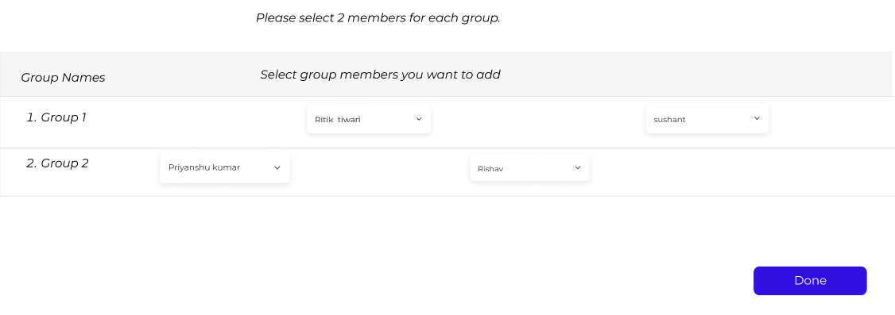
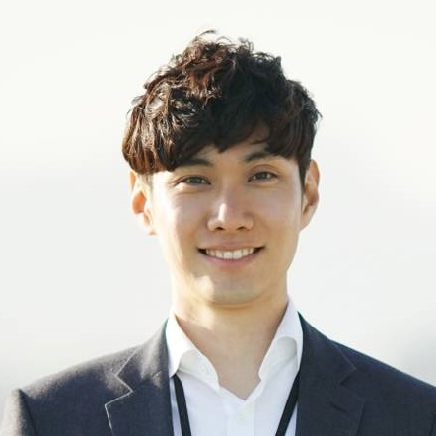

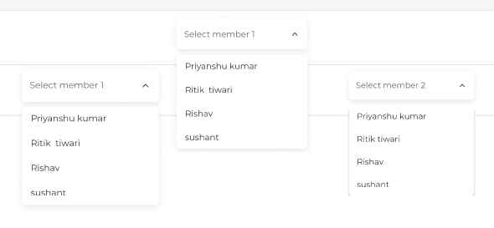
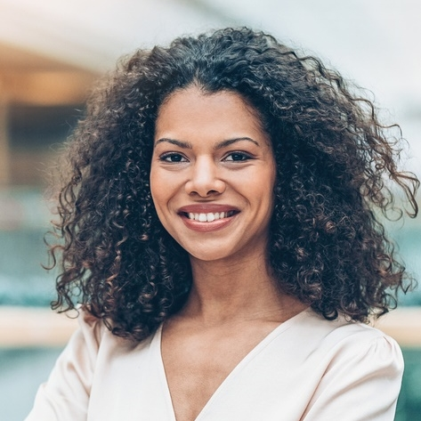

Meet our team
Takuma Hayashi
Mirjam Nilsson
President
Chief Executive Officer
Member addition option has been given in this way for customized group creation .
Flora Berggren
Rajesh Santoshi
Let’s say professor has selected these students for the groups whom he likes to send the task to these two groups. Now if he taps on done then there will be pop message appear which shows that the customized group creation successful. Then when he taps on the Ok button on the pop message it will redirect the user to the assign task screen.
Chief Operation Officer
VP Marketing

Slide 8
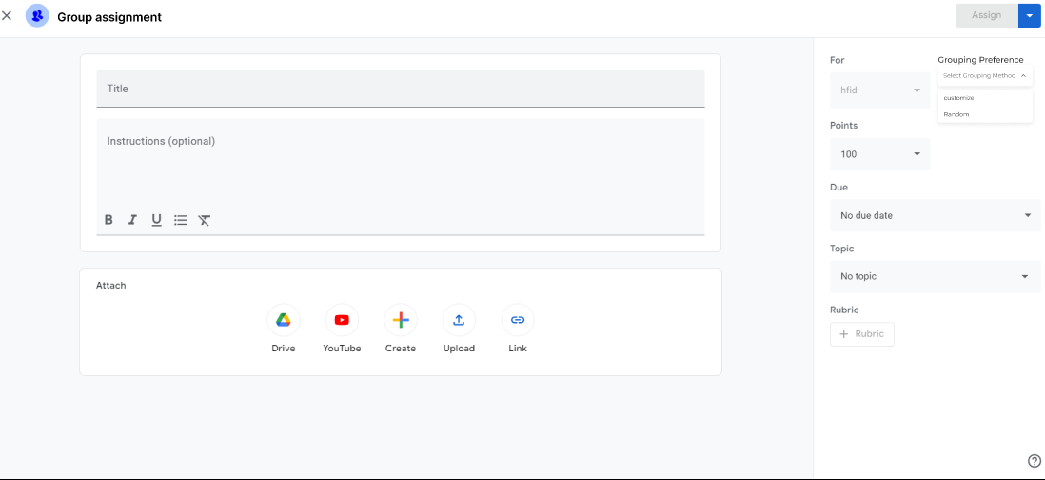
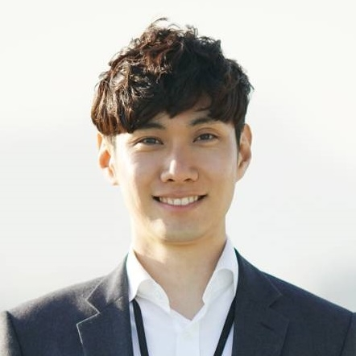


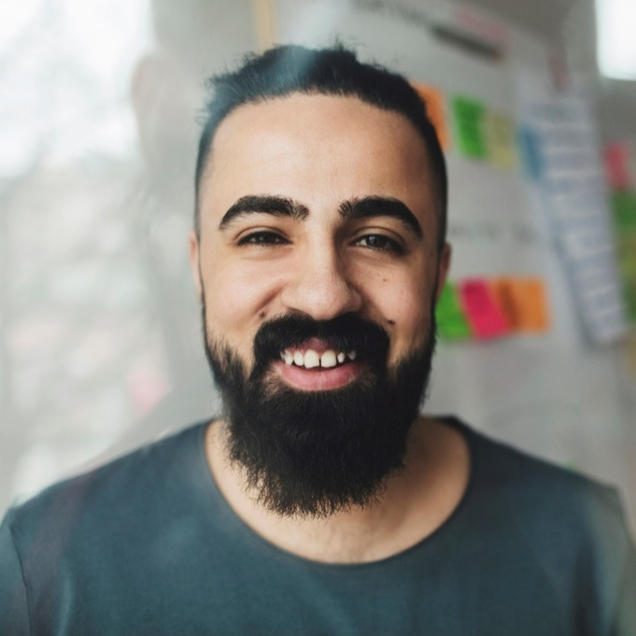
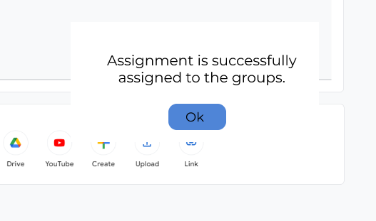




The full team
Takuma Hayashi
Mirjam Nilsson
Flora Berggren
Rajesh Santoshi
President
Chief Executive Officer
Chief Operations Manager
VP Marketing
Here when professor has done with the group creation either with the customize or random then here we have given a button at the top right assign by tap on that the groups are assigned with the task. For the user engagement we have also try to give the pop up message which shows the assignment send successfully.
Graham Barnes
Rowan Murphy
Elizabeth Moore
Robin Kline
VP Product
SEO Strategist
Product Designer
Content Developer

Slide 9
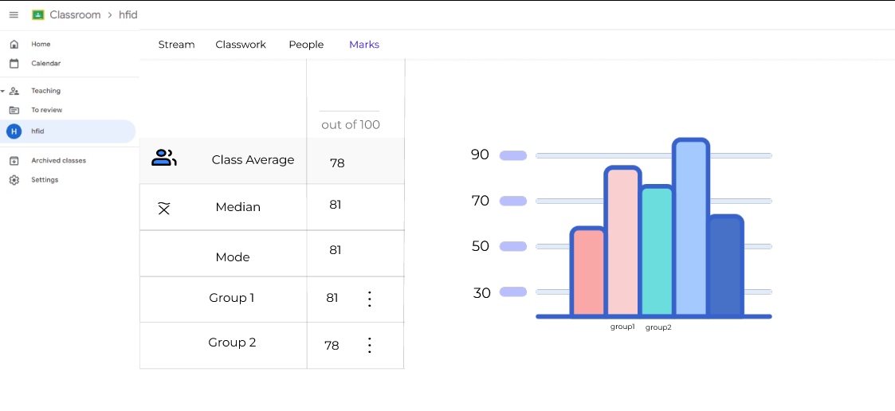
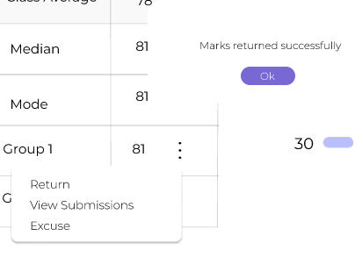
Plan for product launch
Deploy strategic networks with compelling e-business needs
Planning
Synergize scalable e-commerce
Marketing
Disseminate standardized metrics
Design
Coordinate
Foster holistically superior methodologies
Launch
Strategy
e-business applications
1
2
3
4
5
Here we are showing how to evaluate groups first professor have to type the marks what he wants to return for the groups and the he has to tap on the three dots then he have the option which shows the return and on tap the group marks returned successfully. We have also shows the confirmation with the help of pop up message which shows the marks returned successfully.

